Slide 1

Leveraging machine learning for Data Loss Prevention
This presentation outlines a next-generation Data Loss Prevention (DLP) tool. It uses a multi-component approach. 24-25J-003

Slide 2






Meet our team!
K.D.S.P Jayawickrama IT21170720 Cyber Security
G.B.T.G Indrajith IT21229220 Cyber Security
H.A.N Nilakshana IT21175602 Cyber Security
P.P Liyanage IT21184758 Cyber Security
Supervisor Mr. Amila Senarathne Senior Lecturer
Co-Supervisor Ms. Suranjini Silva Senior Lecturer

Slide 3
Agenda
1
Introduction & Motivation
2
Research Problem & Objectives
Background and why a new DLP approach is needed.
Outlining the core issues and goals of our research.
3
System Architecture Overview
4
Component Breakdown
High-level view of the DLP system's structure.
Deep dive into each module: data classification, risk scoring, authentication, and steganalyis.
5
Implementation & Technologies
6
Demo & Results
Details of how the system was built, including tools and languages.
A live demonstration and performance data of the DLP.

Slide 4
Introduction & Motivation
Growing Security Concerns
Limitations of Traditional DLP
Key Innovation
Organizations face increasing data exfiltration risks through various channels.
Integration of ML, DL, and homomorphic encryption creates a multi-layered defense.
Rule-based systems have high false positives and limited context awareness.
Our solution adapts to emerging threats and provides actionable intelligence.

Slide 5

Research Problem & Objectives
RESEARCH QUESTION
How can a Data Loss Prevention (DLP) tool, integrating homomorphic encryption, brute force attack mitigation, steganographic detection, and machine learning-based threat scoring, be developed to ensure secure data processing and effective threat detection in diverse environments?

Slide 6
Objectives
1
Content protection through classification
2
Risk Scoring via behavioral analysis
Analyze user behavior patterns to identify and assign risk score to each individual.
Classify sensitive data to prevent unauthorized access and data leakage through out homomorphic encryption.
3
Enhanced security through authentication
4
Advanced threat detection (steganography)
Implement robust authentication mechanisms to ensure only authorized users can access sensitive data.
Detect and prevent data loss through advanced steganography techniques.

Slide 7





System Architecture Overview
Integrated Components
Four modules work as a unified system.
Deployment Model
Endpoint agents with centralized server.
Information Flow
Detection to Analysis to Response.
Key Features
Real-time monitoring across channels.
Secure, encrypted communication between components.

Slide 8
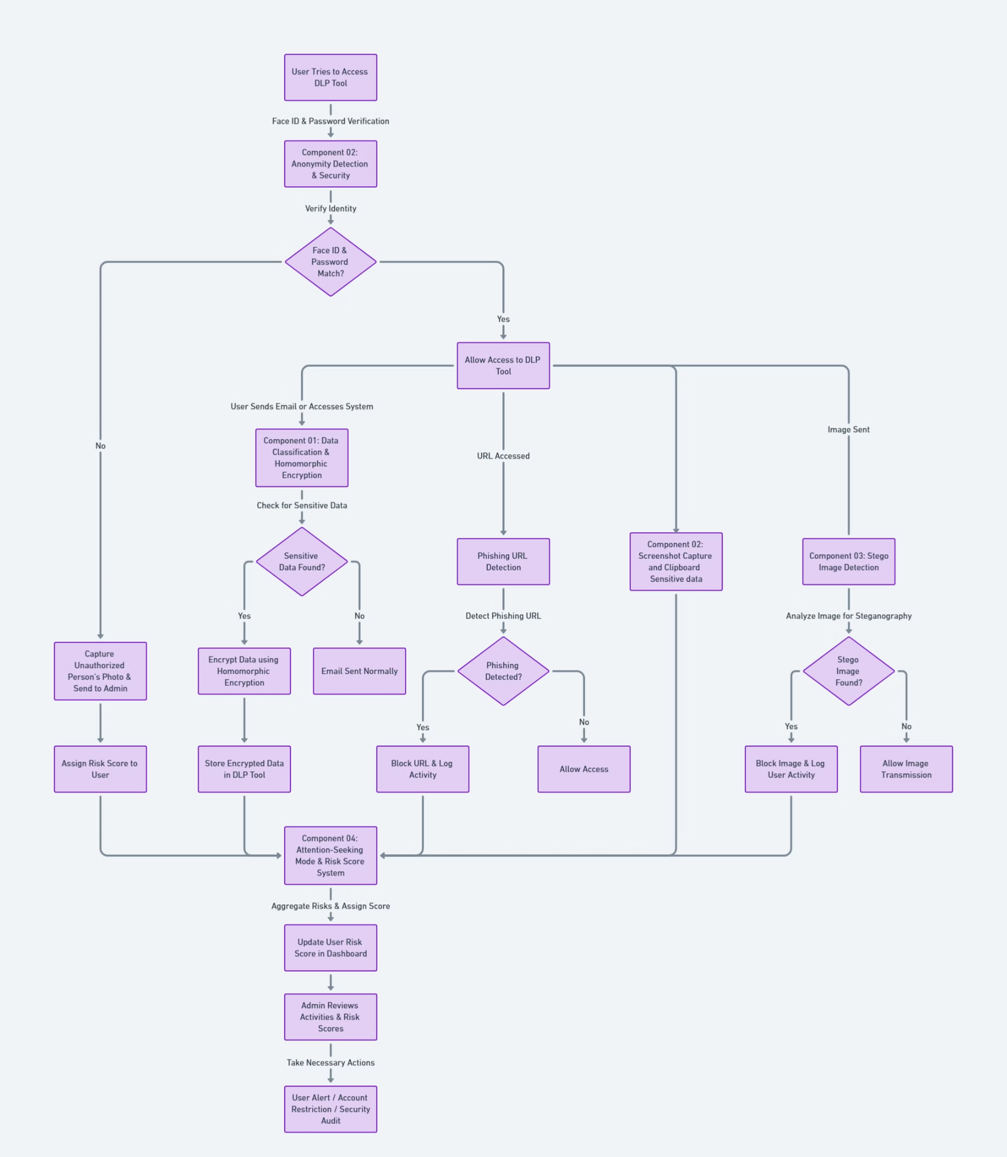
System Architecture

Slide 9


Sulaksha Punsara
IT21170720
K.D.S.P Jayawickrama
BSc (Hons) in information Technology Specializing in cyber security
Homomorphic Encryption for Data Processing

Slide 10

Homomorphic Encryption for Data Processing
Homomorphic encryption enables secure data processing by allowing computations on encrypted data without decryption, addressing privacy concerns in various sensitive fields. However, it struggles with large files, necessitating a solution that combines data classification to effectively manage smaller, sensitive data. This integration enhances data security and ensures compliance with privacy regulations while facilitating secure analysis and processing of critical information.

Slide 11
Why Advanced Data Classification Matters
Current Data Breach Landscape
Traditional Solution Limits
Our Innovation
Pattern matching misses novel attempts
Context-aware classification using ML and enforce the homomorphic encryption for sensitive details. Adaptive system learns from new threats. Balances security with operations.
Average breach cost: $4.45M
67% insider exfiltration
Rule-based systems generate false positives
82% experienced data exposure
Manual classification isn't practical

Slide 12
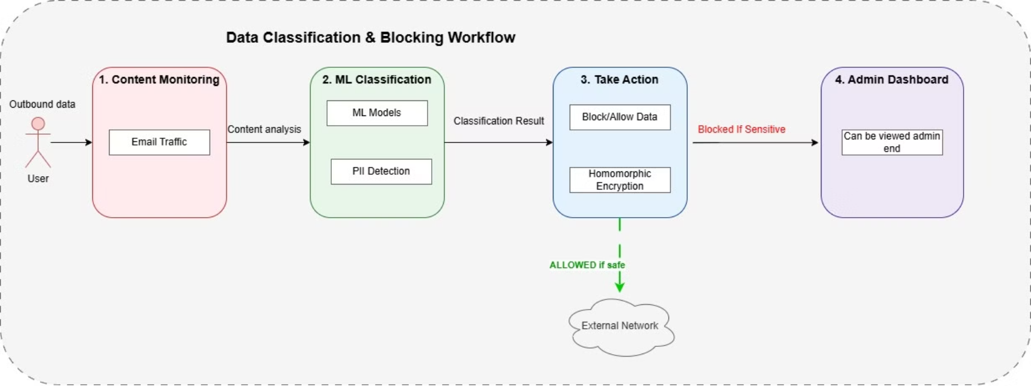
Functional Workflow

Slide 13




Classification & Blocking Process
Intercept & Monitor
Analyze & Classify
Take Action
Log & Secure
Process via ML models. Identify sensitive content. Assign sensitivity score.
Block or allow based on sensitivity.
Record incident data. Apply homomorphic encryption. Feed violation data to risk scoring.
Capture outbound data before it leaves. Monitor multiple channels. Preserve original content.

Slide 14




Research Frontiers & Next Steps
Advanced Classification
Integration Expansions
User Experience
Multimodal analysis. Improved context understanding. Zero-shot learning.
Expanded cloud coverage. Real-time threat intelligence. Data sharing controls.
Adaptive warning system. Self-service exception handling. Educational feedback.

Slide 15
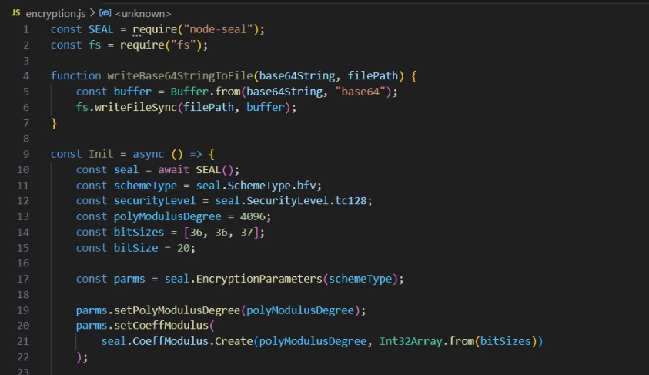
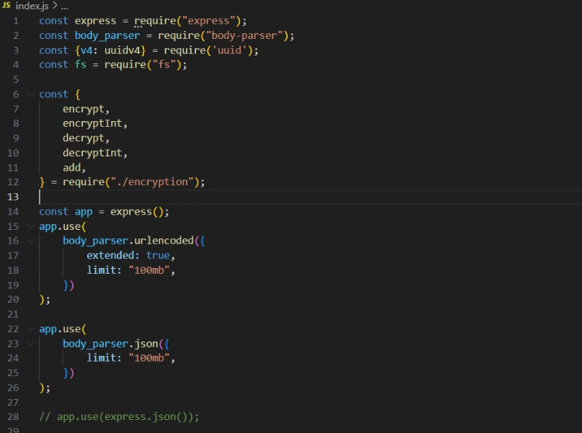
Demo

Slide 16


Pubudu Priyanga
IT21184758
P.P Liyanage
BSc (Hons) in information Technology Specializing in cyber security
Attention-Seeking Mode with a Score System Using Machine Learning

Slide 17

Risk Scoring System
This slide introduces Component 2: a machine learning based risk scoring system. It is a dynamic user risk assessment engine. The engine quantifies security threats in real-time. Its core purpose is to identify high-risk users. This identification occurs through behavioral analytics and violation patterns.

Slide 18
Why Risk Scoring Matters
Traditional Security Limitations
Risk Assessment Challenges
Binary decision making provides incomplete security context. It struggles distinguishing accidental misuse from malicious intent. Alert fatigue arises from treating all violations equally.
Many security teams struggle to prioritize alerts effectively. The average enterprise faces thousands of monthly security alerts. Few organizations have visibility into high-risk behaviors.
Our innovation offers continuous risk assessment. We use behavioral pattern analysis to identify threats. Contextual scoring considers user role, data sensitivity, and intent.

Slide 19
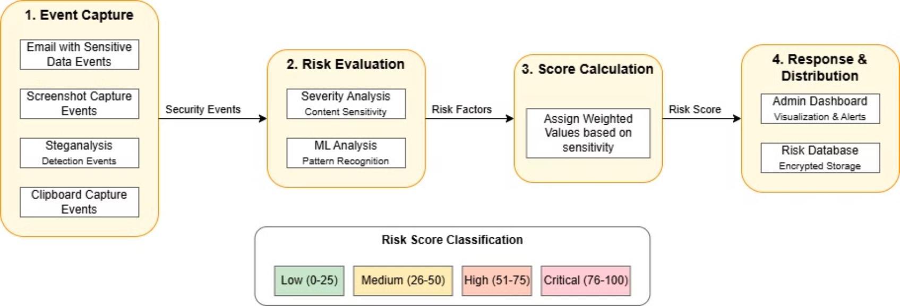
Risk Scoring System Workflow

Slide 20
How It Works: Risk Calculation
Event Capture
Risk Evaluation
Score Calculation
Response
Receive security events. Collect activity logs. Integrate findings and historical data.
Analyze event severity. Evaluate user intent signals. Consider contextual factors.
Assign weighted values and calculate risk scores.
Update risk scores and display user based risk scores on admin dashboard.

Slide 21
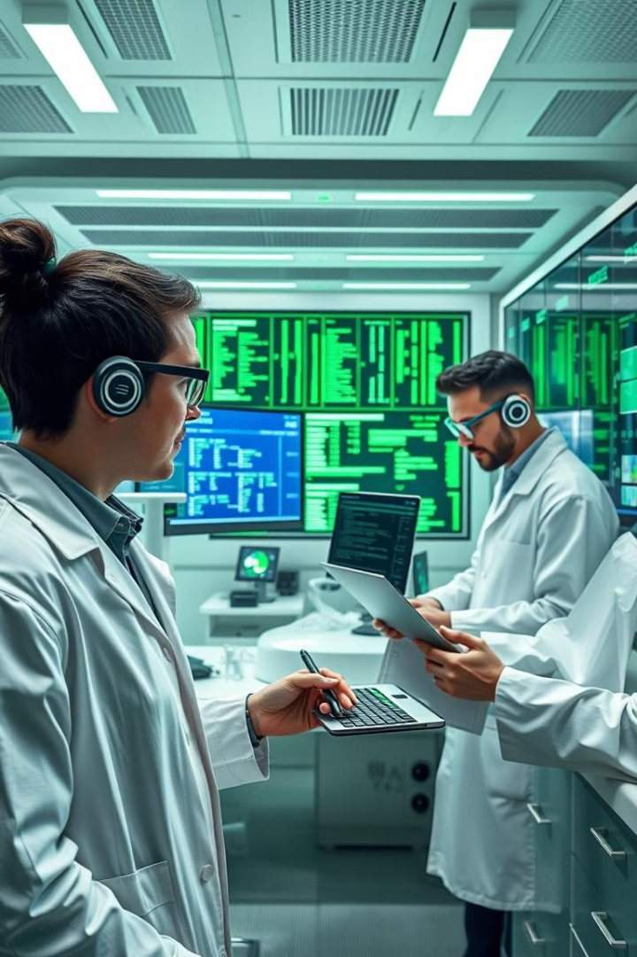
Research Frontiers & Next Steps
Advanced Analytics
Enterprise Integration
We're developing predictive risk modeling and cross-user correlation. We want to incorporate external threat intelligence feeds.
We plan an extended API ecosystem and integration with physical access controls. We will expand risk scoring.
Adaptive Learning
We will create self-tuning algorithms. Weighting factors will refine based on correlation. We will adjust to new threats.
We are researching privacy, behavioral indicators, and organizational culture.

Slide 22
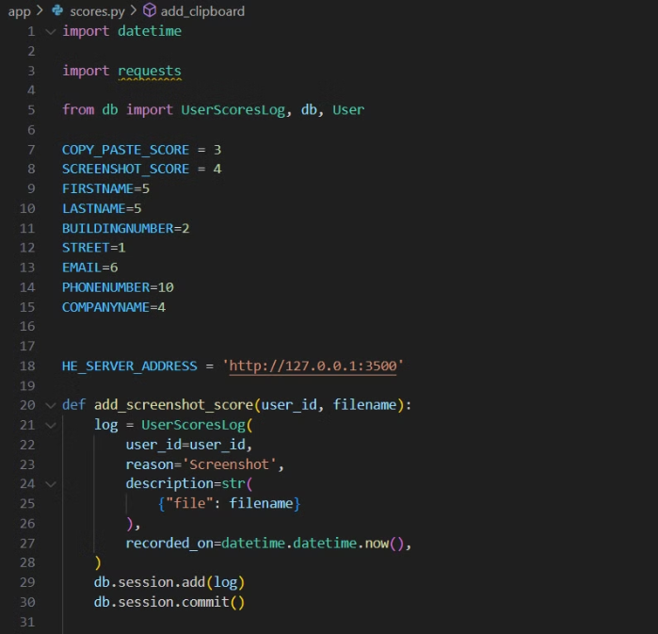
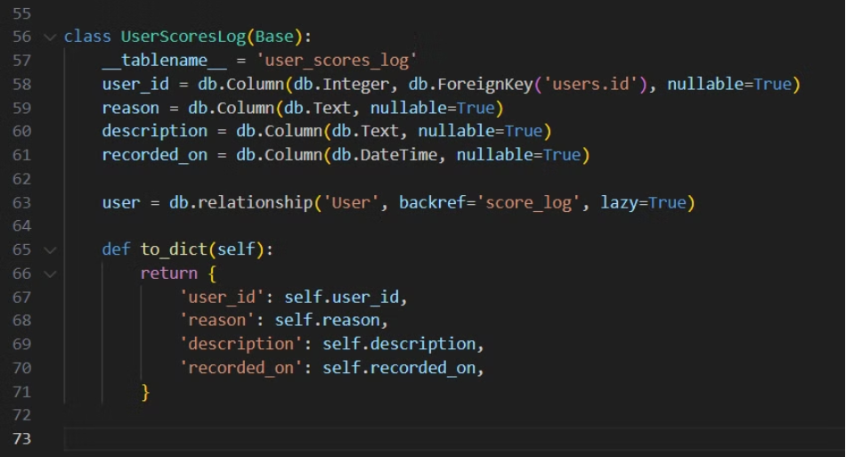
Demo

Slide 23


Neelaka Nilakshana
IT21175602Results & Performance Metrics
H.A.N Nilakshana
BSc (Hons) in information Technology Specializing in cyber security
Anonymity Detection & URL blocking and browser security

Slide 24

Anonymity Detection & URL blocking and browser security
Component 3 provides comprehensive security and identity verification. It is a vital layer of our Data Loss Prevention (DLP) solution. This component enforces secure access. It continuously monitors user activity for suspicious behavior.

Slide 25
Evolving Authentication & Monitoring Challenges
Traditional Authentication Weakness
Sophistication of Attacks
Our Innovation
Credential stuffing and phishing techniques are on the rise. Insider threats require constant vigilance and behavioral monitoring.
We provide multi-factor authentication with biometrics. Also, we give continuous activity monitoring to detect abnormal usage.
Password-only systems are vulnerable to credential theft. Breaches often involve stolen credentials.

Slide 26
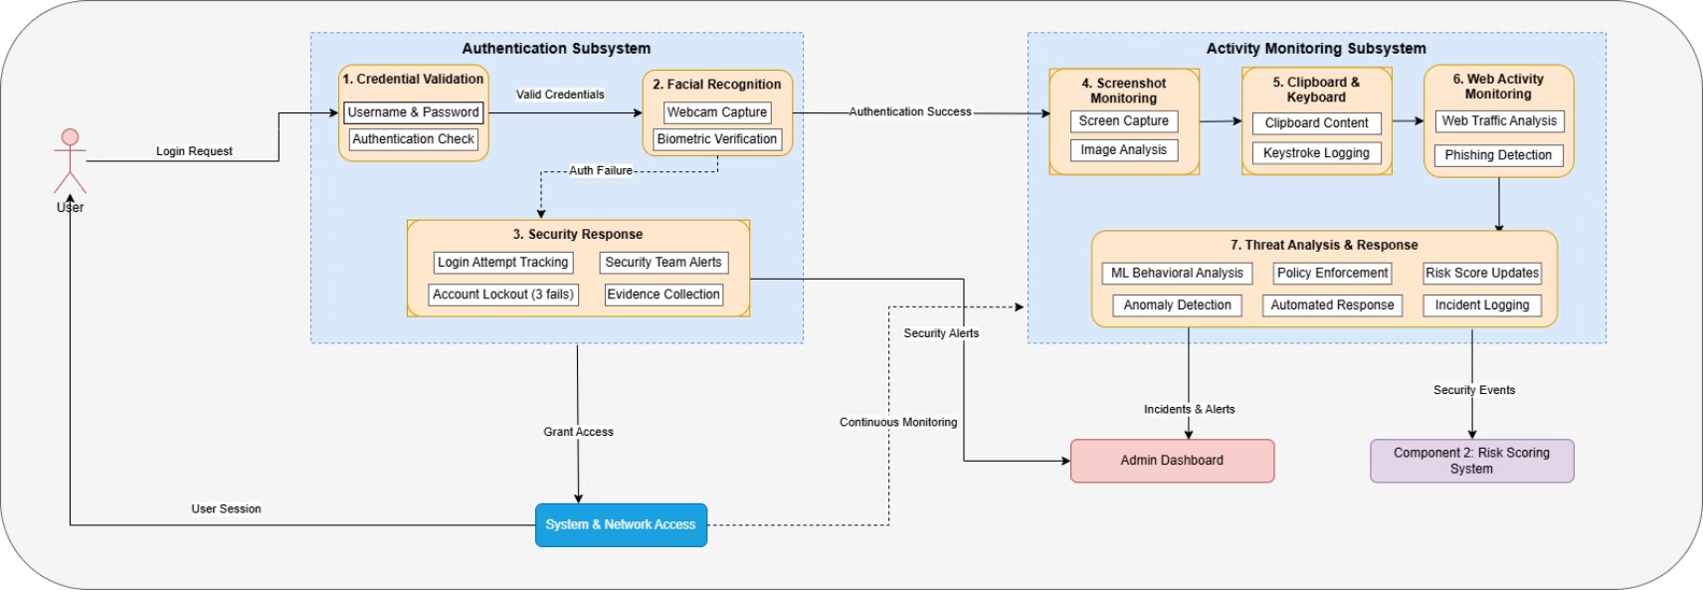
Functional workflow

Slide 27

Enhanced Authentication Architecture
1
Multi-Layer Authentication
2
Facial Recognition Security
Our system requires DLP login. It features facial recognition verification and integrates with organizational systems.
The system uses webcam capture. It also uses biometric comparison and liveness detection to prevent spoofing.
3
Suspicious Access Controls
Automated account locking occurs after failed attempts. The security team receives notifications with evidence.

Slide 28




Comprehensive User Activity Monitoring
Clipboard Monitoring
Screenshot Surveillance
Anonymity Login Attempts Monitoring
Captures clipboard content. Identifies sensitive data, blocking exfiltration.
Periodic screenshot capture analyzes images for sensitive information.
Identify abnormal login attempts using face id.

Slide 29




Authentication & Monitoring Workflow
Initialization
The DLP agent starts at system boot. Authentication is required.
Authentication
The system validates user credentials and face id. Then, it checks status.
Continuous Monitoring
Background services monitor user activities with event triggers.
Alert & Response
Real-time notifications alert security. Violations are blocked.

Slide 30
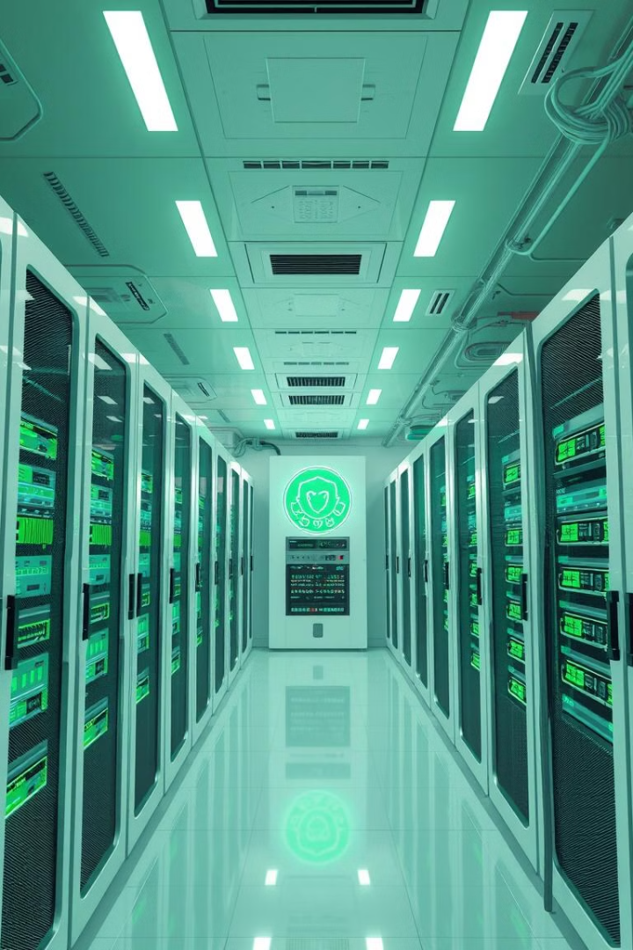
Under the Hood: Technical Architecture
Agent Architecture
Machine Learning Components
Low-level integration with tamper resistance. It has minimal performance impact.
Facial recognition uses CNNs. Anomaly detection has LSTM models.
Security Mechanisms
End-to-end encryption protects data. It verifies agent integrity.

Slide 31




Advanced Phishing & Malicious Site Protection
Web Traffic Interception
1
Phishing Detection
2
4
User Protection Workflow
3
Machine Learning Models

Slide 32

In Action: Authentication & Monitoring Scenario
1
Unauthorized Attempt
A user enters stolen credentials. They fail verification.
2
Security Response
The system captures webcam data. It sends a security alert to admin.
3
Legitimate User Access
The legitimate user verifies. The system grants access.
4
Continuous Protection
The system blocks phishing sites. Events get logged.

Slide 33

Innovation Roadmap & Research Directions
Authentication Advancements
Enhanced Monitoring
Continuous facial recognition
Audio monitoring for discussions
Behavioral biometrics
AI conversation analysis
We will innovate in authentication. Also, we will improve monitoring. This ensures long-term security.

Slide 34
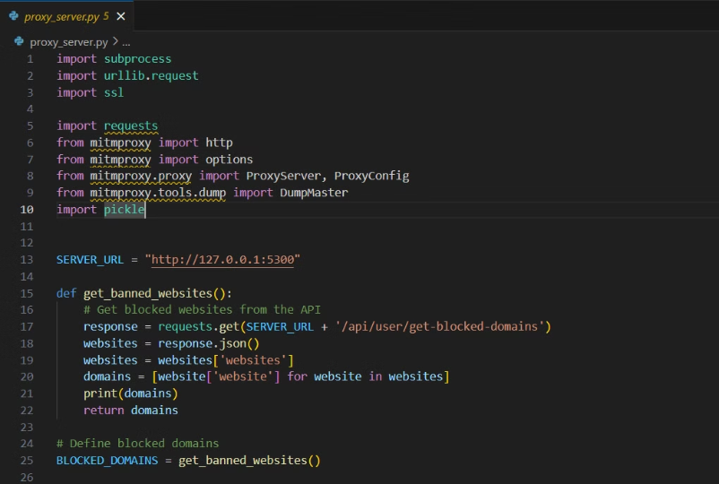
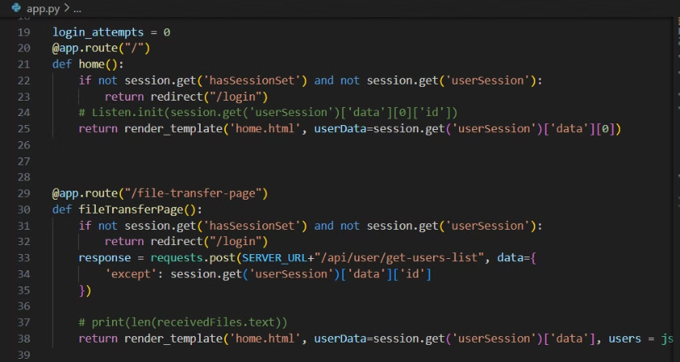
Demo

Slide 35


Tharindu Gihan
IT21229220
G.B.T.G Indrajith
BSc (Hons) in information Technology Specializing in cyber security
Stego Images Detection

Slide 36
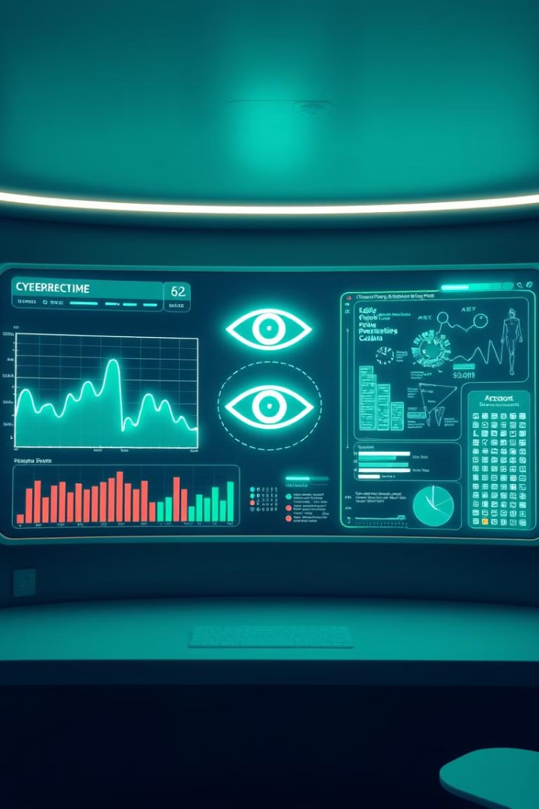
Steganalysis & OCR Tool
This presentation introduces Component 4. It is an advanced image analysis engine. The engine detects both hidden data and visible sensitive text. It will prevent data exfiltration through steganography.

Slide 37
The Hidden Threat & Visible Risk
Steganography Threat
Text in Images: The Overlooked Vector
There is a growing use of steganographic techniques. These techniques hide sensitive data. Conventional DLP solutions are unable to detect it.
Screenshots containing sensitive information can bypass text-based DLP. Documents are shared as images. This helps evade content monitoring.

Slide 38
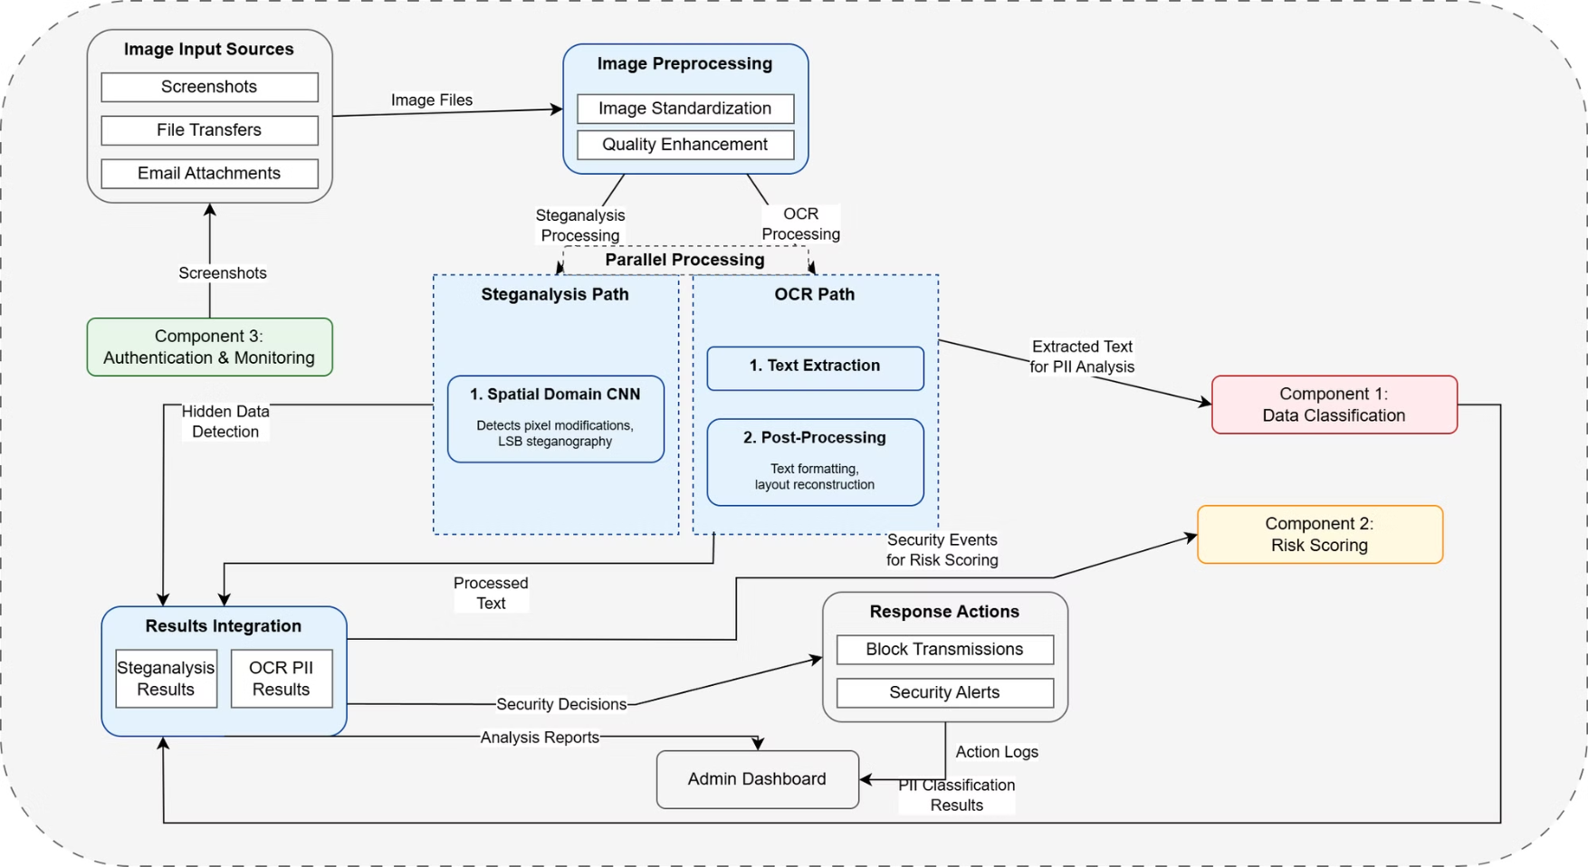
Functional Workflow

Slide 39



Dual-Path Image Analysis Architecture
Steganalysis Path
Deep CNN models specialized in spatial and DCT domains. Probability scoring of steganographic content. Binary classification with confidence scores.
OCR Processing Path
Image pre-processing for optimal text recognition. Advanced OCR engine with support for multiple languages. Direct integration with Component 1.
Unified Results Management
Consolidated threat assessment from both paths. Prioritized alerting based on confidence levels. Detailed forensic information.

Slide 40

Deep Learning Steganalysis Models
1
Spatial Domain Model
2
DCT Domain Model
3
Ensemble Learning
Detects pixel-level modifications. 96.3% accuracy on LSB steganography detection. Trained on 500,000+ image pairs.
Identifies frequency-based hiding techniques. 94.8% detection rate. Specialized in detecting transform domain techniques.
Combined model predictions for greater accuracy. Reduced false positive rate. Adaptive weighting based on image characteristics.

Slide 41



OCR Processing & PII Detection
Advanced Text Extraction
PII Recognition Process
Performance Optimization
Multi-stage preprocessing. Deep learning-based OCR engine with 98.2% character accuracy. Layout analysis for context preservation.
Direct integration with Component 1's engine. Extracted text is analyzed for sensitive information patterns. Context-aware PII detection.
Parallel processing of image segments. Selective high-resolution processing for detected text regions. Asynchronous processing.

Slide 42
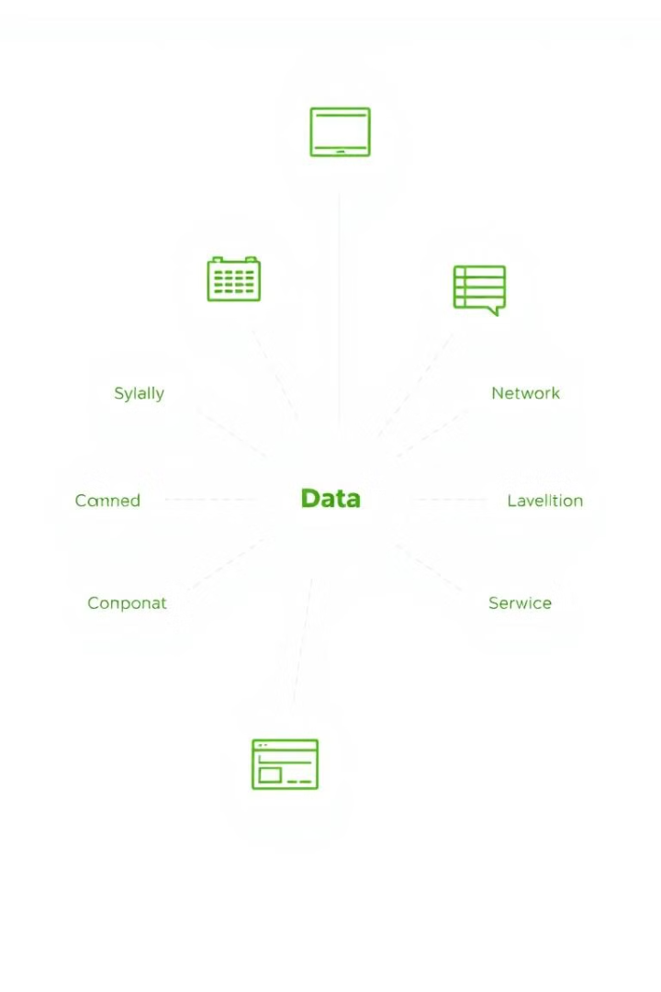
Component Integration & Operational Workflow
1
Image Preprocessing
Standardization and quality enhancement.
2
Parallel Analysis
Steganalysis path: Hidden data detection. OCR path: Text extraction to Component 1.
3
Unified Risk Assessment
Combined threat evaluation.
4
Response Actions
Blocking of transmissions with detected hidden data. Prevention of image sharing with PII.

Slide 43
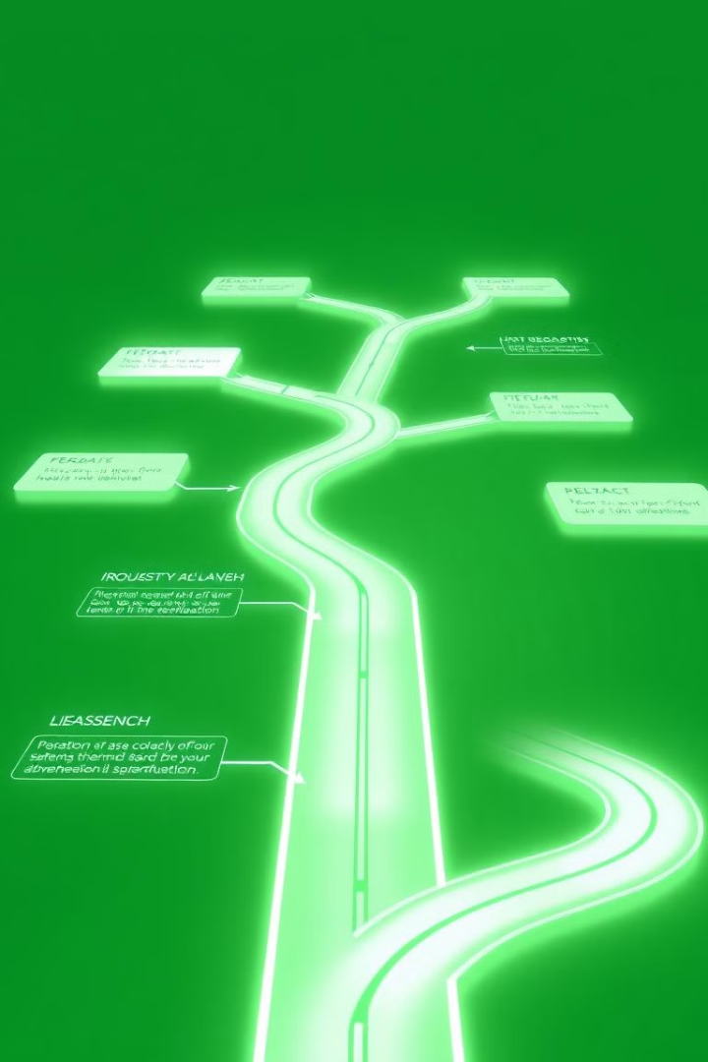
Results & Innovation Roadmap
Comprehensive Protection
Extended Coverage
97.3% success rate in identifying PII in image-based content.
94.7% overall detection rate for steganographic content.
Future Research
Integration of video steganalysis. Expansion to audio steganography. Enhanced OCR for handwritten text.

Slide 44
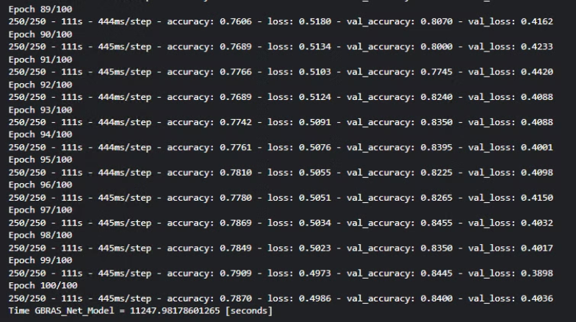
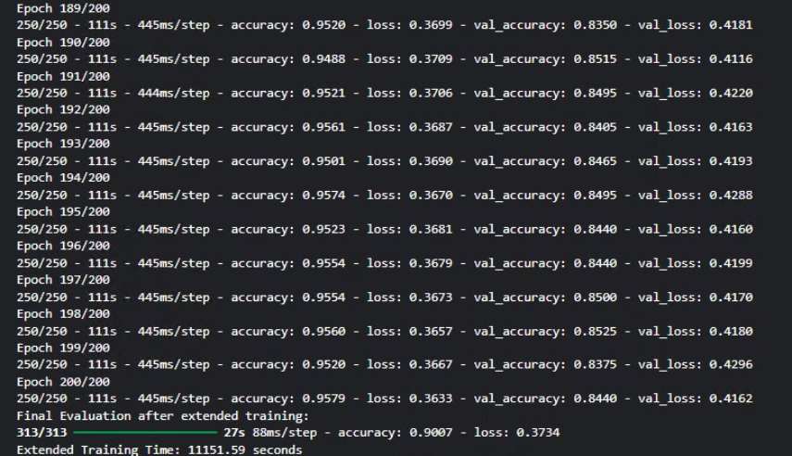
Model improved results before and after

Slide 45
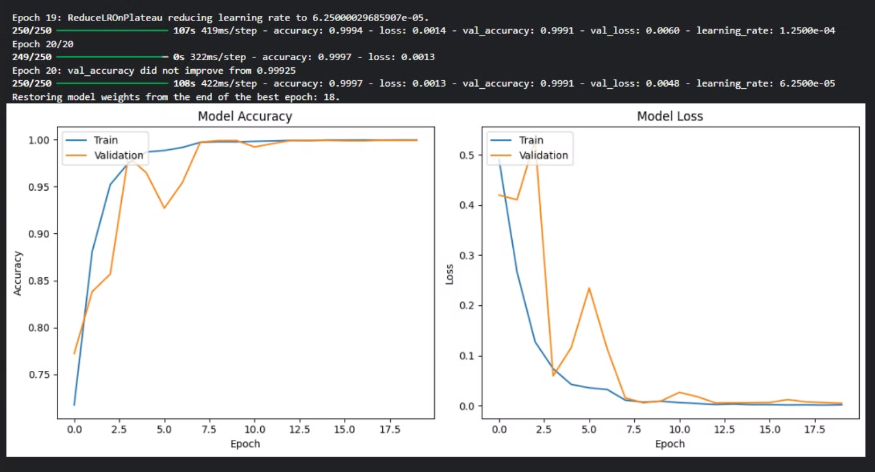
Specifically trained LSB model
Specially trained for LSB steganalysis

Slide 46
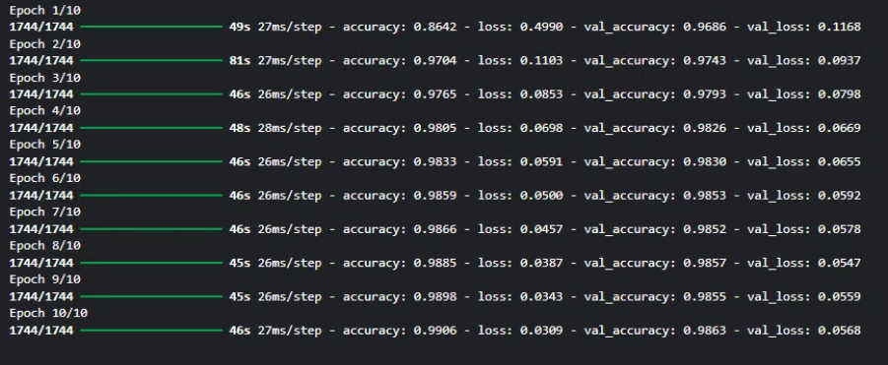
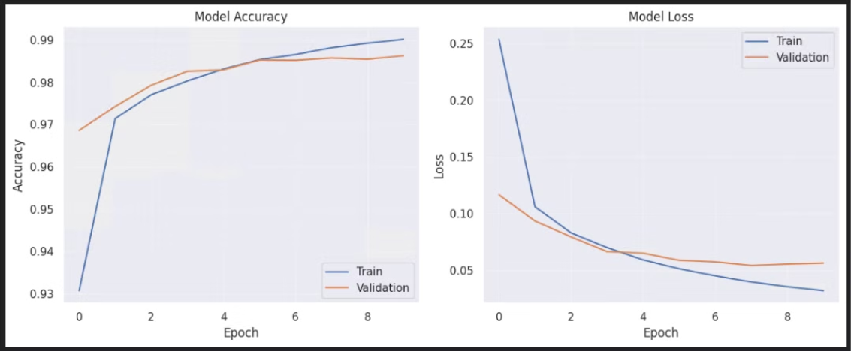
Optical Character Recognition (OCR) model

Slide 47
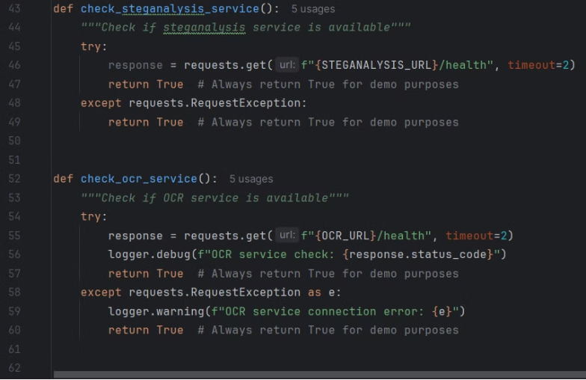
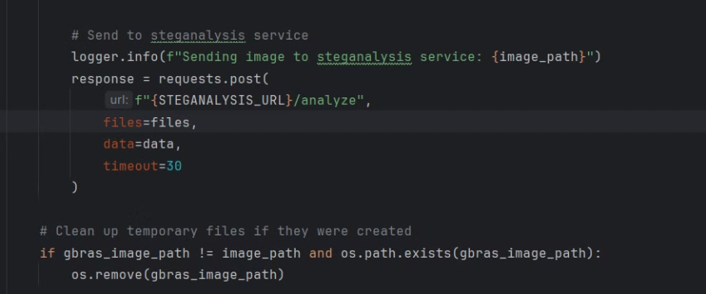
Demo

Slide 48
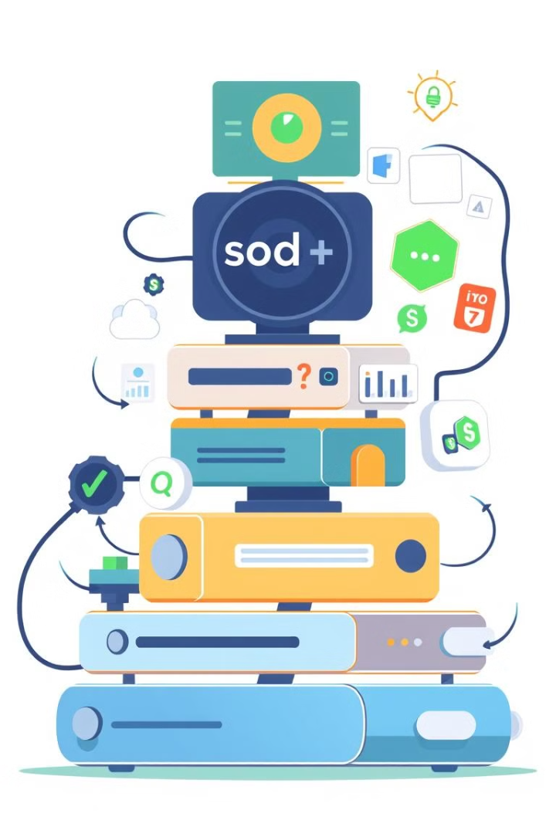
Technology Stack & Methodology
Machine Learning
NLP models, anomaly detection
Deep Learning
CNNs, computer vision
Security
Homomorphic encryption
The system integrates using a microservices architecture.

Slide 49
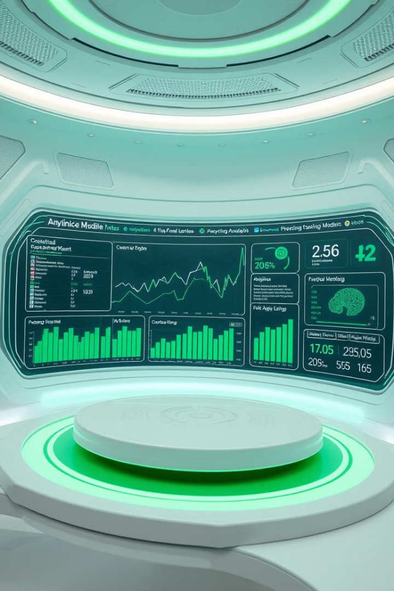
Future Enhancements for the DLP System
Model Improvements
Continuous training with new threat data and advanced behavioral analytics.
System Expansion
Cloud service and mobile device support. Integration with SIEM platforms.
User Experience
Reduced false positives, customizable dashboard, and self-service options.

Slide 50

Commercialization Value
1
Market Needs
2
Key Features
Prevents data breaches with strong security.
Data discovery and classification.
Meets demand for sensitive data protection.
Homomorphic encryption for securing data.
Detects steganography to filter data.
Monitoring and risk scoring to evaluate risk.

Slide 51

Commercialization Value
1
Target Markets
2
Regulated Industries
Large enterprises with extensive data operations need DLP. SMEs need scalable, cost-effective data protection.
Healthcare, finance, and legal sectors require compliance. They must protect sensitive data.
3
Revenue Models
4
Managed Services
Subscription-based licensing offers tiered plans. Perpetual licensing involves a one-time purchase.
Continuous monitoring ensures clients have ongoing support. Consulting and training help with implementation.

Slide 52
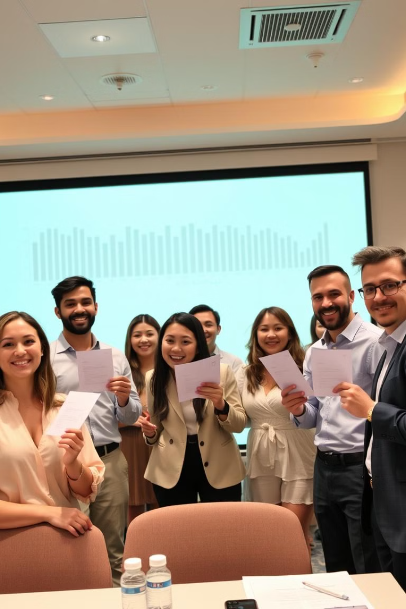
Conclusion
Our DLP system offers key innovations. It uses an integrated multi-component approach. Machine learning improves detection. Homomorphic encryption provides secure logging. Our system also offers user-centric risk assessment.
Our research contributes advances in applied security. We offer a novel approach to steganography detection. We also offer a practical implementation of theoretical security concepts.

Slide 53

Any Questions?

Slide 54

Thank You
We appreciate your time and attention today.
We look forward to collaborating with you on data loss prevention.

